Slide 1

Shining (Dark)Light on Interactions with the Dark Sector
Gabby Gelinas
On behalf of the DarkLight Collaboration
MSc student at The University of British Columbia
Supervised by Katherine Pachal and Michael Hasinoff

Slide 2
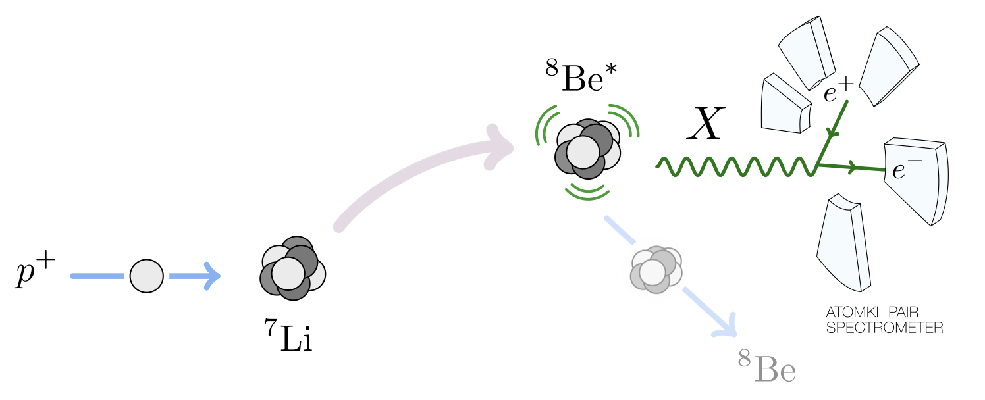
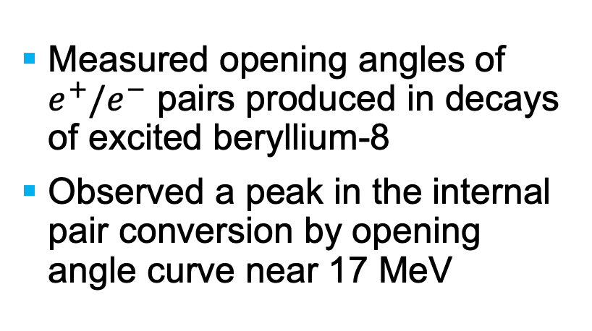
DarkLight Experiment Motivations
Atomki Experiment
Measured opening angles of $e^{+}/e^{−}$ pairs produced in decays of excited beryllium-8
Observed a peak in the internal pair conversion by opening angle curve near 17 MeV
Phys. Rev. D 95, 035017 (2017)
/11

Slide 3
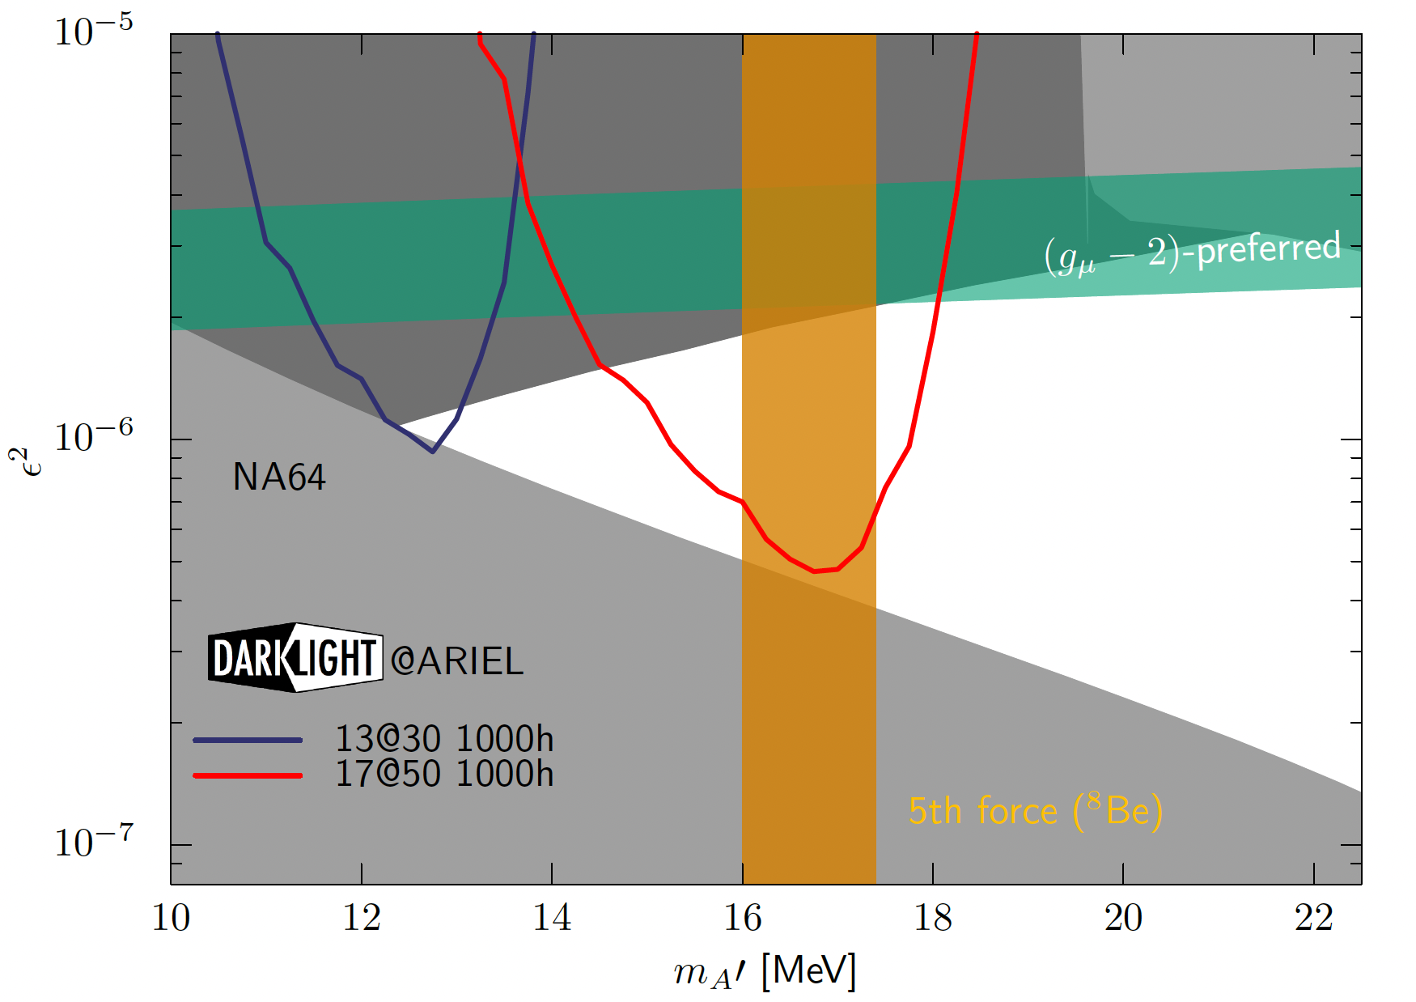
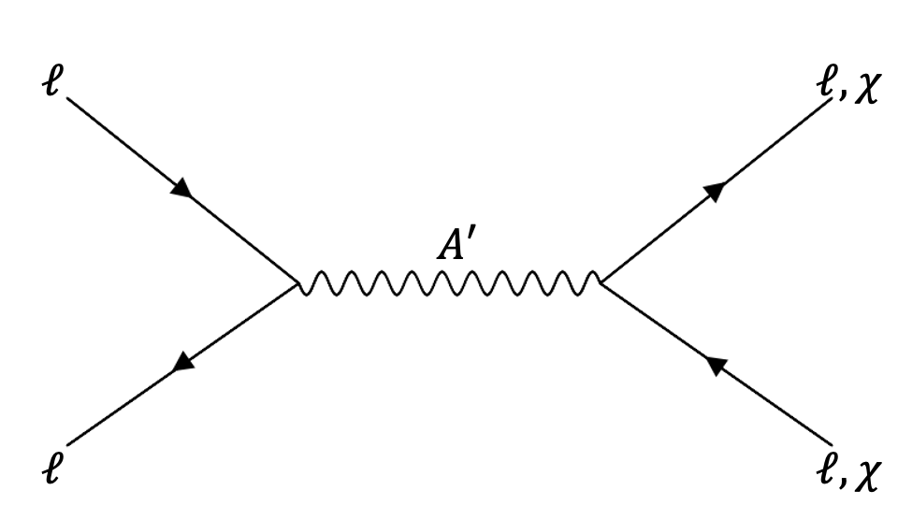
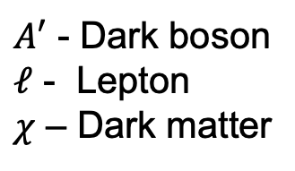

Dark Boson Model of Interest
An X17-like dark boson must be:
Massive
Massless is not compatible with our universe
An axial vector
Satisfy conservation of angular momentum in observed decays
Protophobic
Proton based experiments have already checked!
$A′$ - Dark boson
$ℓ$ - Lepton
$χ$ – Dark matter
/11

Slide 4
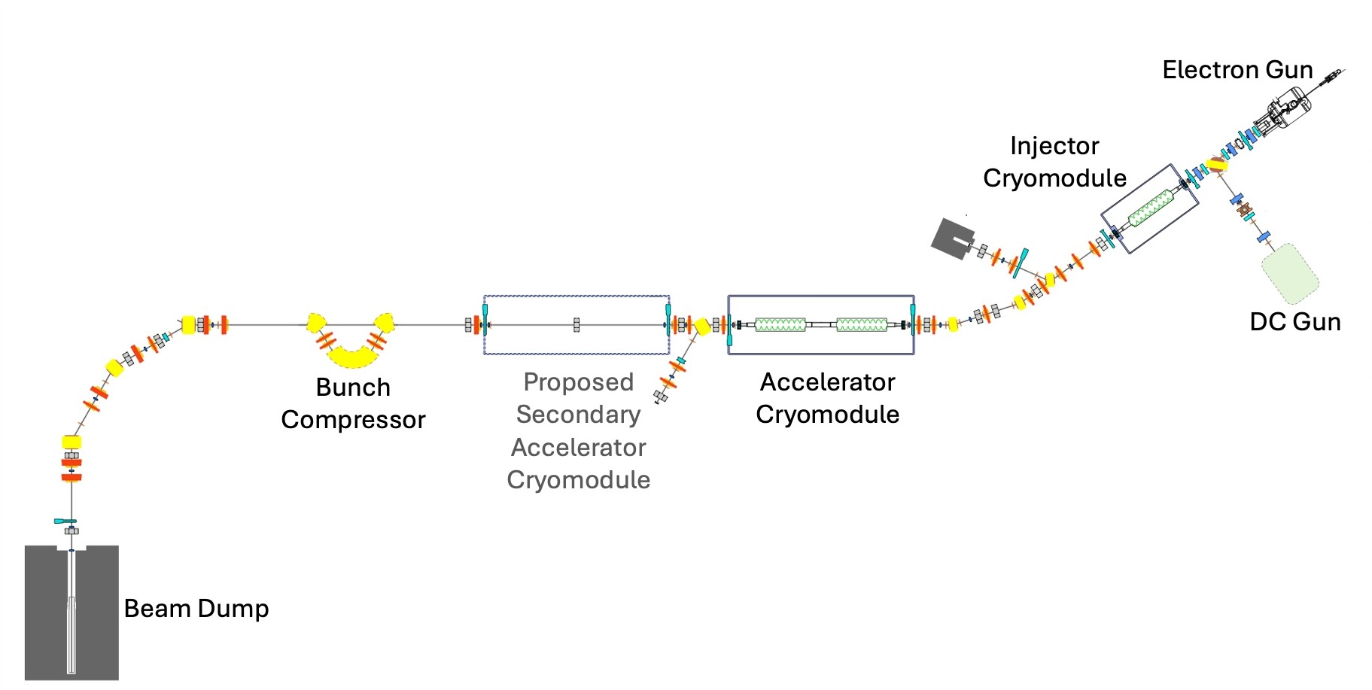
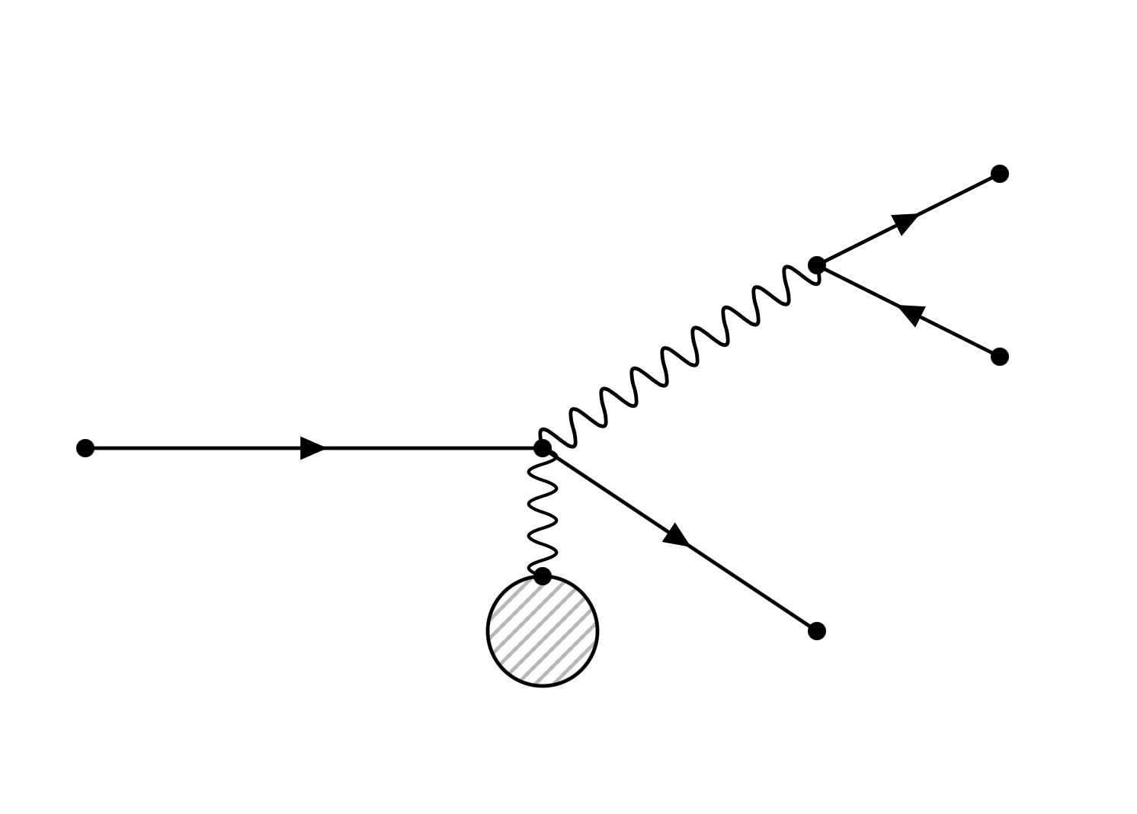

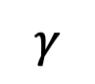
Dark Boson Production
30 MeV beam energy
e-
DarkLight
$$γ$$
e+
e- beam
$$A′$$
Modified from DOI: 10.18429/JACoW-ERL2019-WEPNEC01
Ta
e-
/11

Slide 5
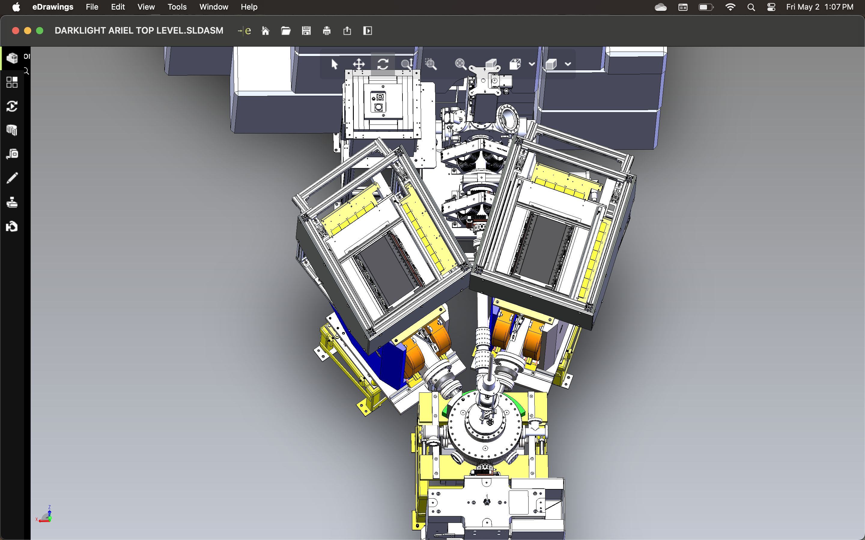
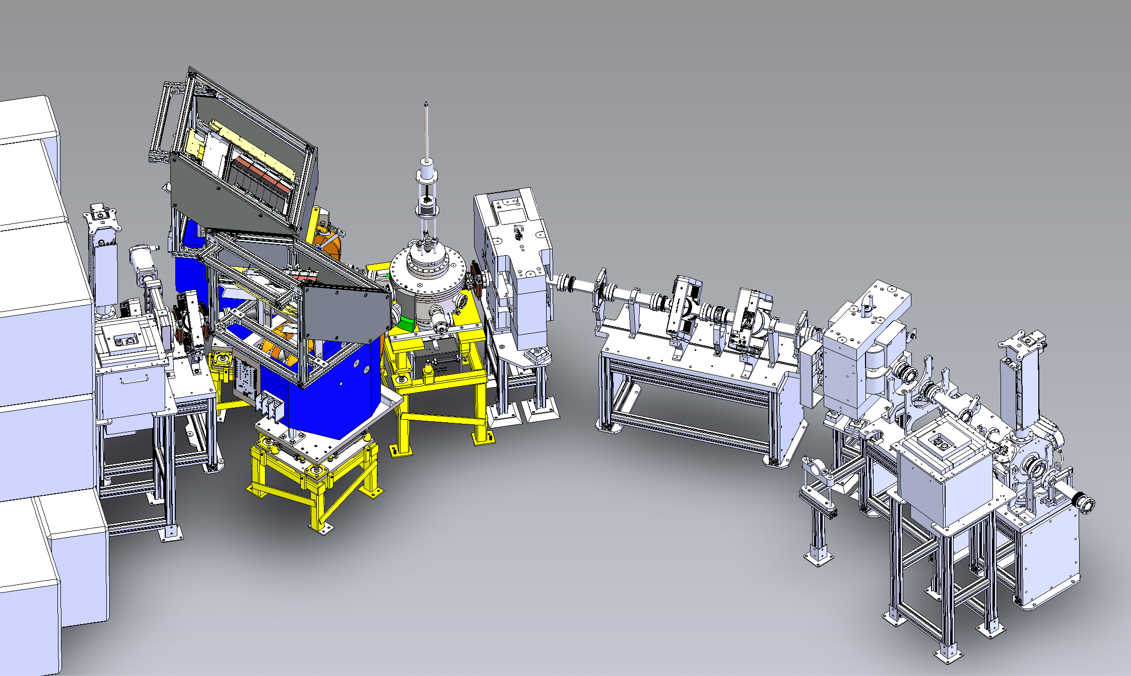
DarkLight Experiment
Trigger system
GEMs
Target chamber
Dipole magnets
Beam Dump Shielding
/11

Slide 6
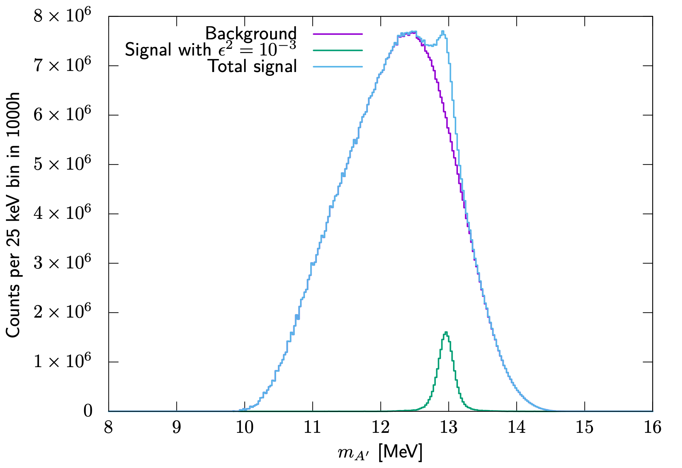
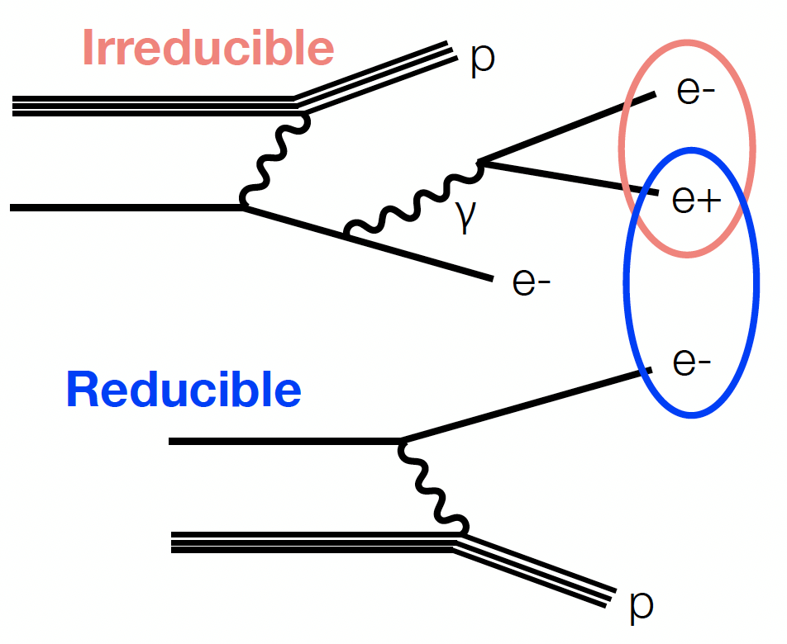
DarkLight Experiment Backgrounds
Exaggerated!
Figure by J. Bernauer
Figure by K. Pachal
/11

Slide 7
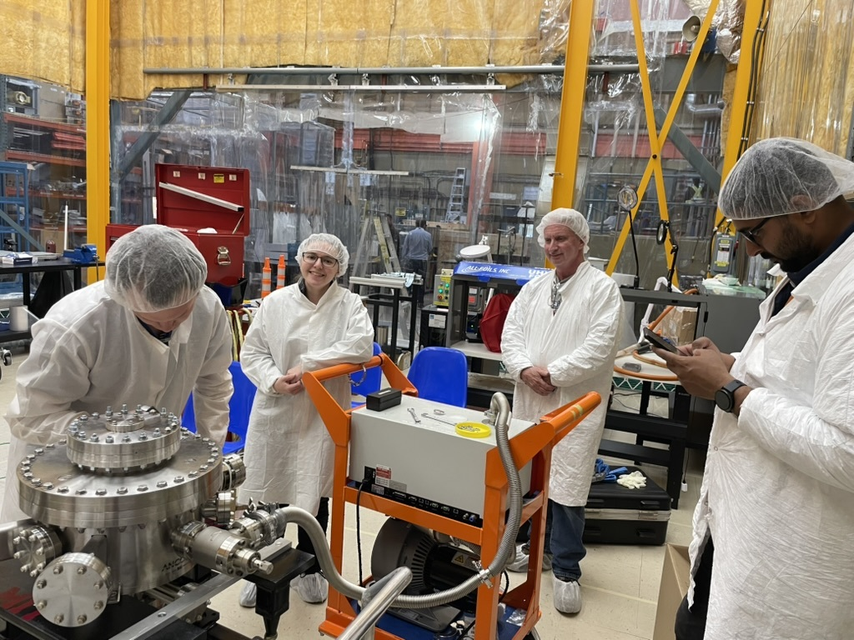
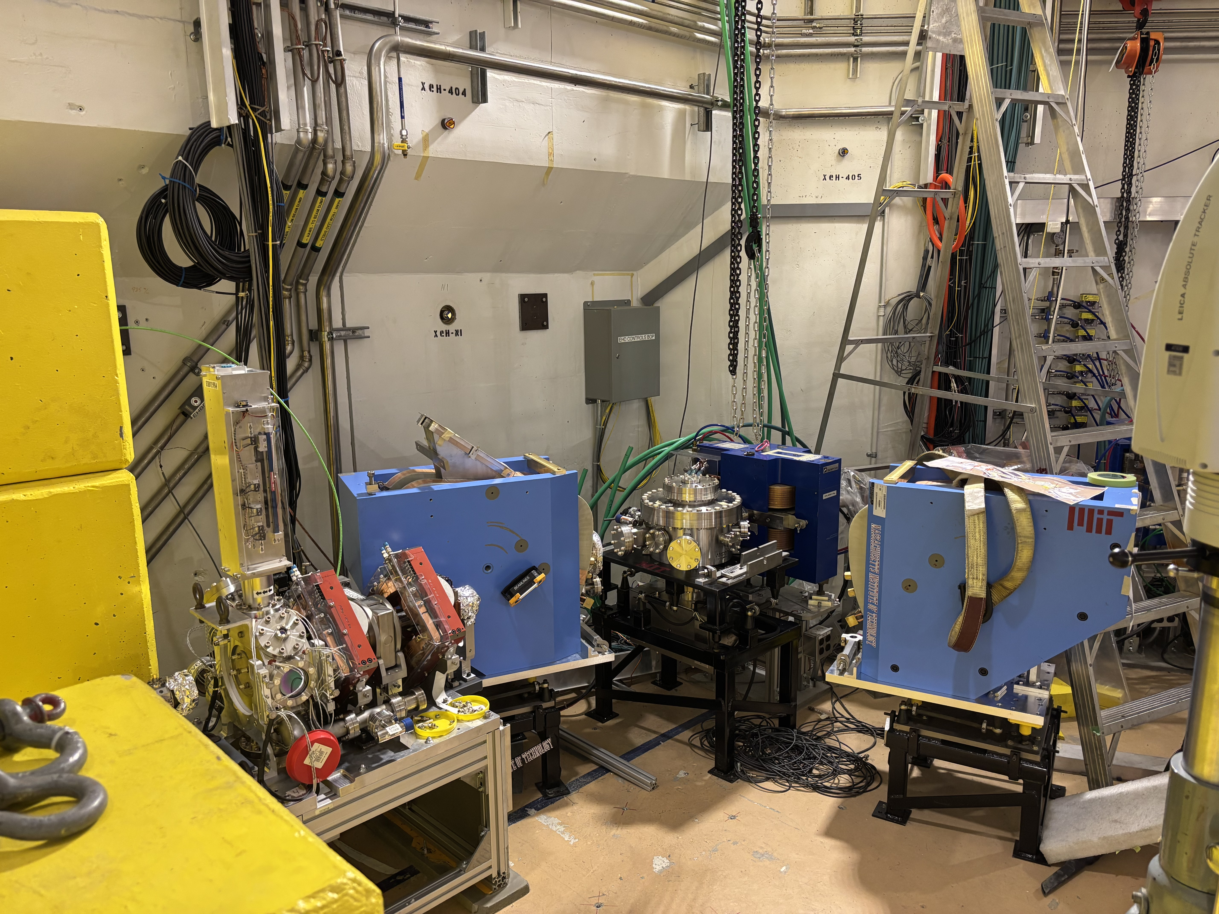
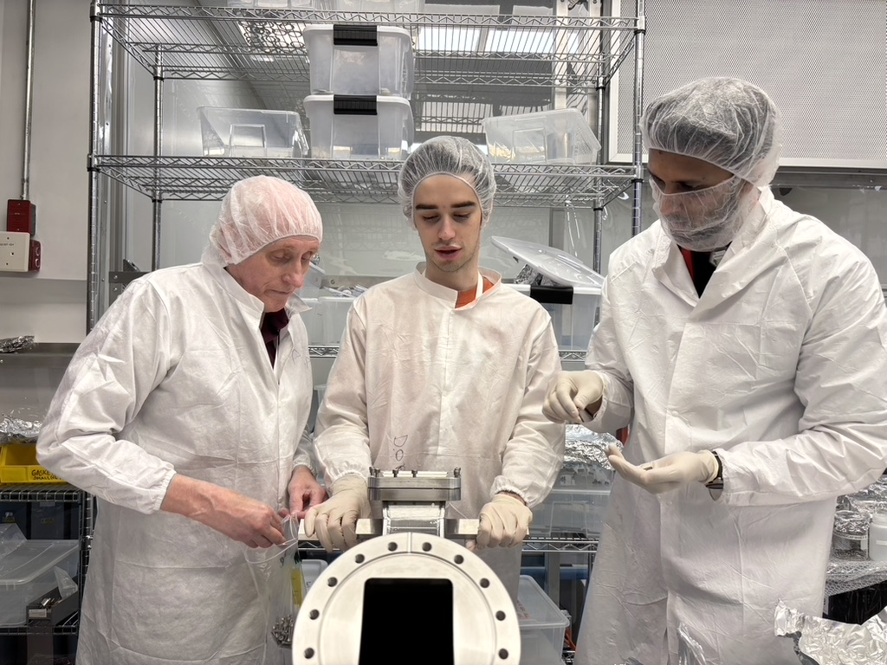
DarkLight’s Timeline
May 2025
June
January 2026+
August
December
Installation
30 MeV Particle search run
30 MeV Analysis and 50 MeV planning
30 MeV Commissioning
/11

Slide 8
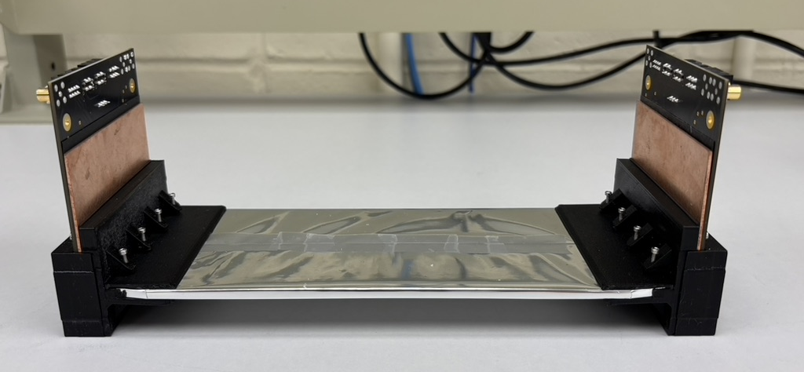
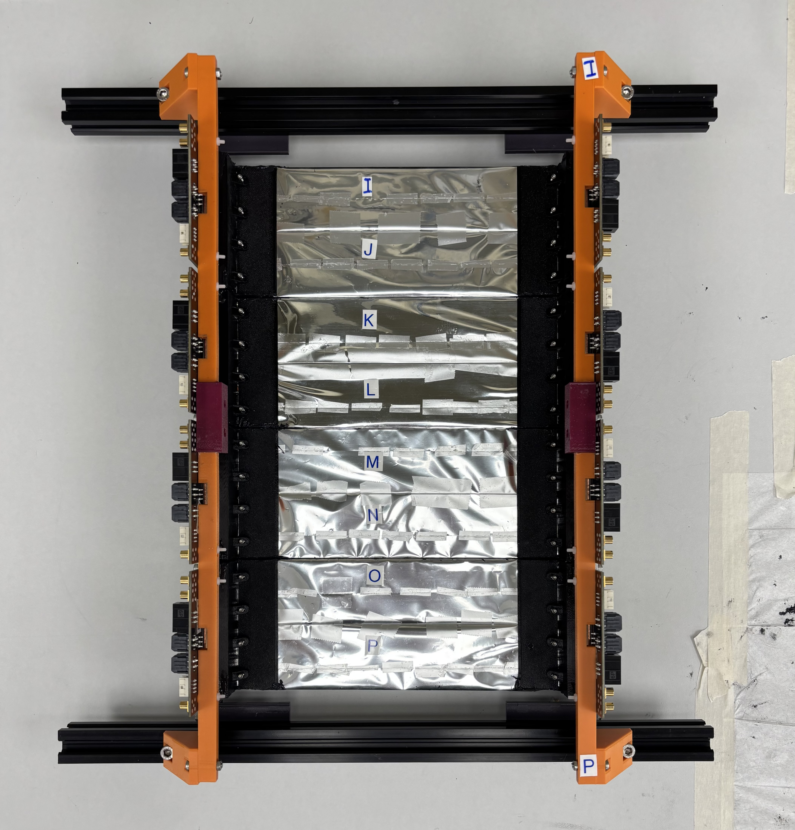
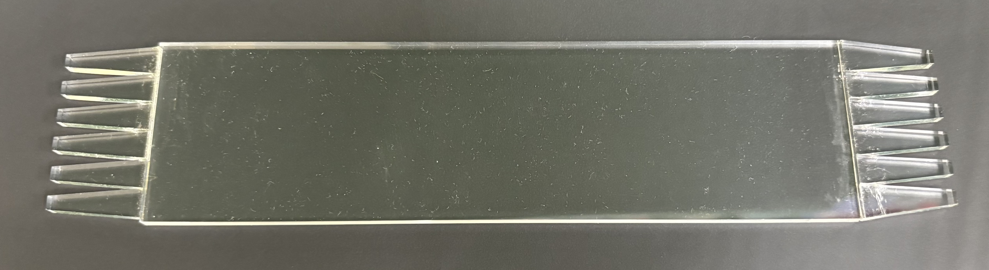
Trigger System: Hardware
/11
Notes:
Starts at 7 minute mark
So, I mentioned how the trigger system is important in reducing our backgrounds and correctly identifying coincident pairs of particles. Understanding this system and maximizing it’s potential is what my work is all about!
Our trigger system is composed of two identical detectors, each made up of eight plastic scintillators. When a charged particle interacts with the scintillator light is produced and directed down the light guides on each end onto a set of six SiPM.
Here, we see the scintillator and an example scintillator pair that we call a paddle. Four of them are mounted together to form our detector, then light sealed which is not shown here.
Another feature you will notice is this copper plate sticking out above the scintillators, this is for cooling since we can’t cool the SiPMs directly due to our light shielding structures.

Slide 9
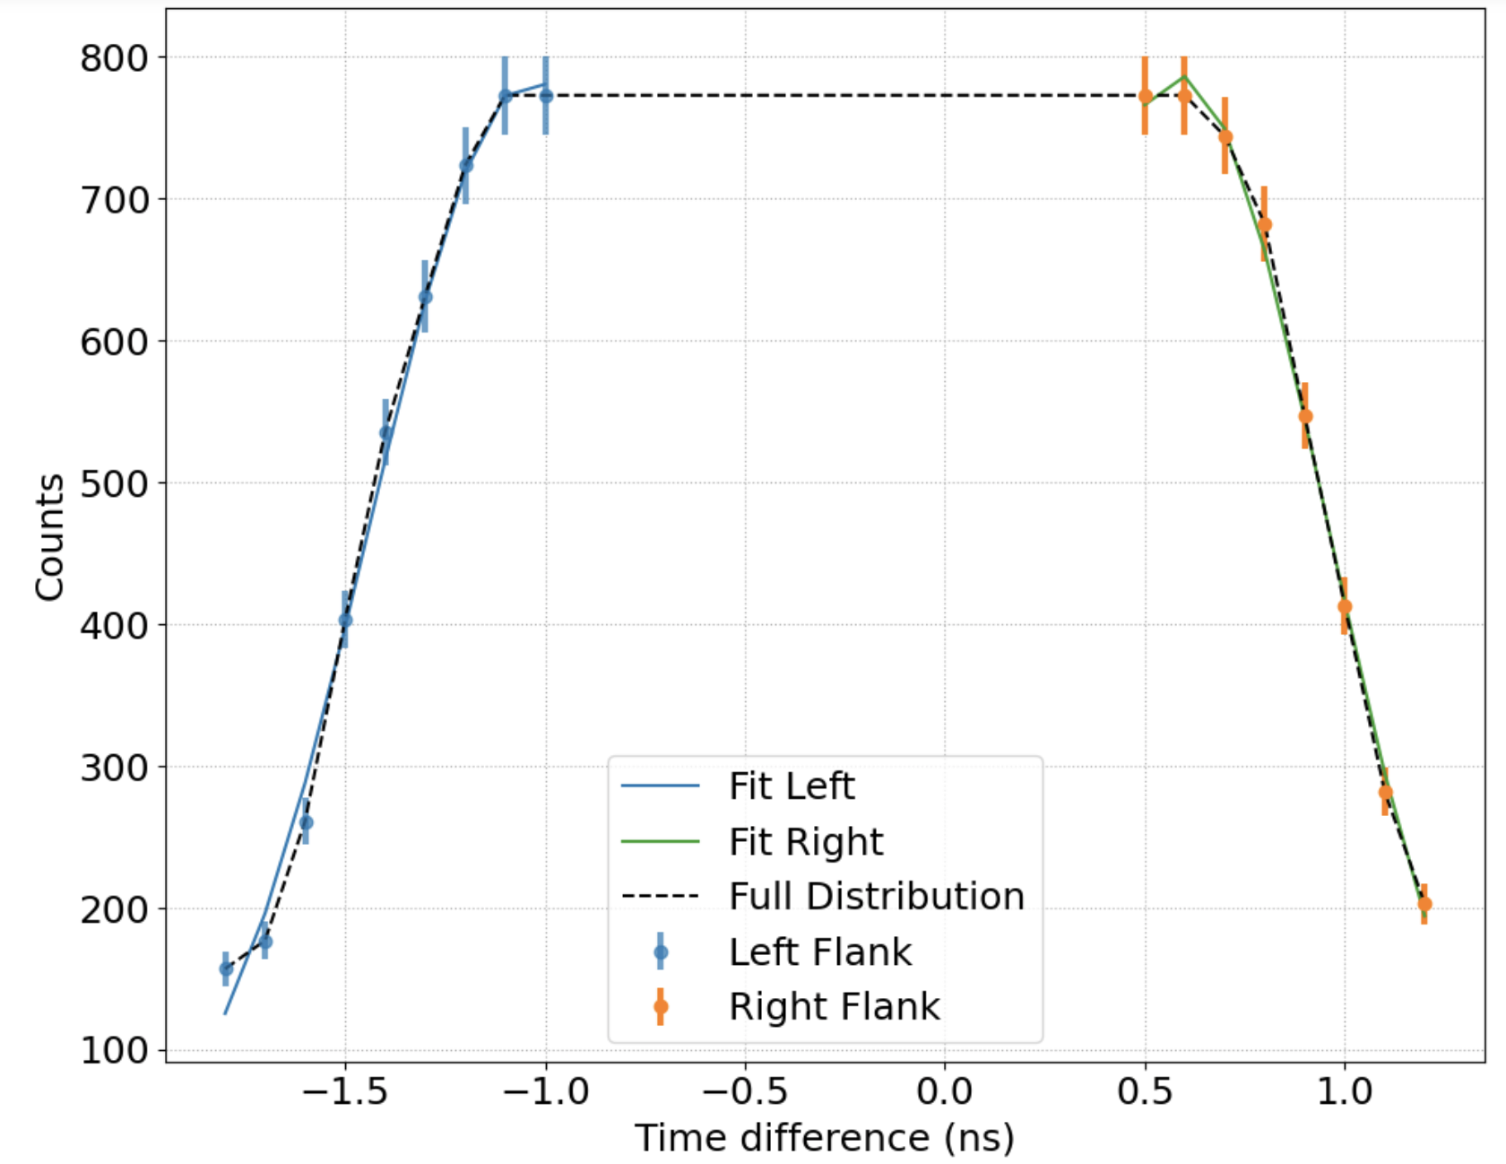
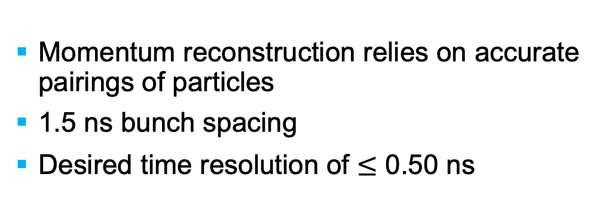
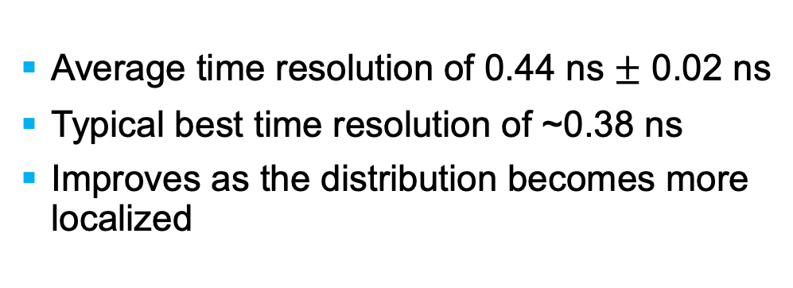
Trigger System: Time Resolution
Momentum reconstruction relies on accurate pairings of particles
1.5 ns bunch spacing
Desired time resolution of $≤$ 0.50 ns
Average time resolution of 0.44 ns $±$ 0.02 ns
Typical best time resolution of ~0.38 ns
Improves as the distribution becomes more localized
/11

Slide 10
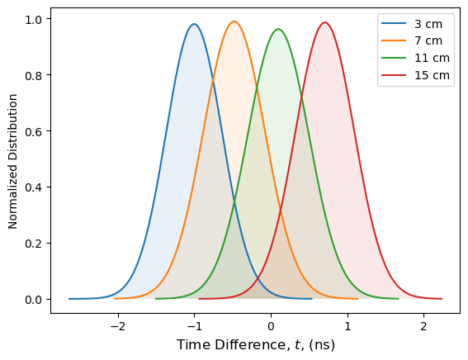
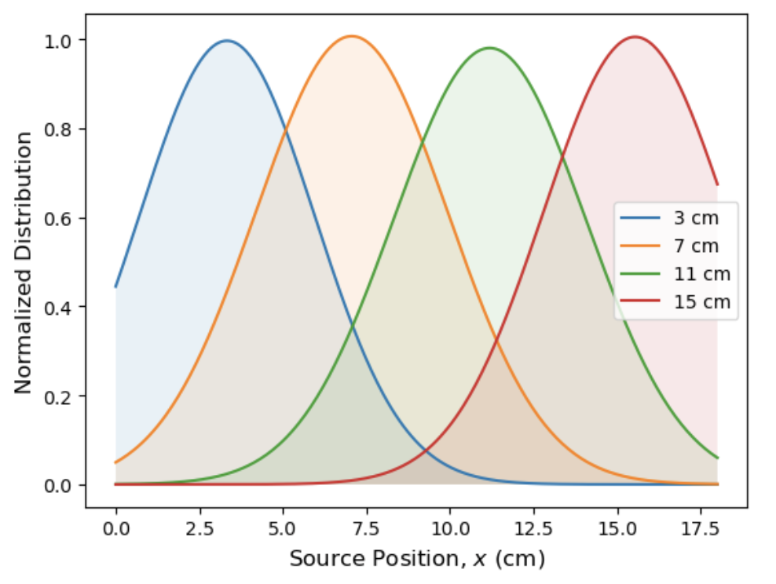

Trigger System: Position Resolution
GEMs are DarkLight’s primary means of hit position determination
What happens when two hits arrive at the GEMs in close succession?
Goal: to use the triggers to identify GEM events of interest
Position resolution of 2.14 cm $±$ 0.08 cm
/11

Slide 11










Summary
DarkLight is well positioned to provide vital information to the search for an X17-like dark boson.
Experiment installation is well underway, and we are on track to complete 30 MeV data collection by the end of 2025.
The DarkLight trigger system is well suited to DarkLight’s needs. A thorough understanding of this system is key in ensuring data quality.
ggelinas@triumf.ca
/11

Slide 12
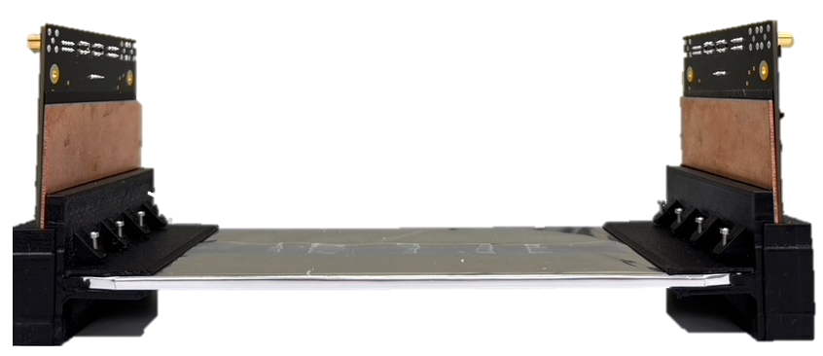

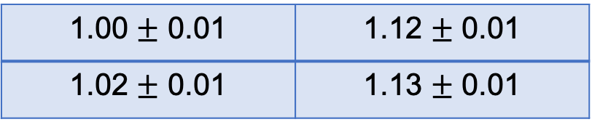
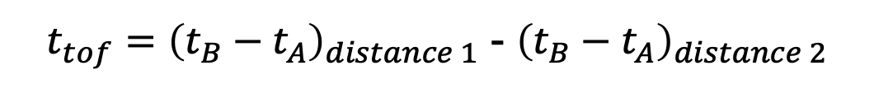
Trigger System: Accuracy Verifications
Goal: verify the time measurement accuracy by measuring the speed of cosmic rays
A
$t_{tof}={\left(t_{B}−t_{A}\right)}_{distance 1}$ - ${\left(t_{B}−t_{A}\right)}_{distance 2}$
Cosmic ray speed as a fraction of $c$ for all scintillator combinations
1.00 $±$ 0.01 | 1.12 $±$ 0.01
1.02 $±$ 0.01 | 1.13 $±$ 0.01
B
Reproducibility concern
Notes:
Talk about when TOF was good and then say, however, we have struggled with the reproducibility of this data then mention how the effect of hardware variations and calibration quality are being examined
- The final point of interest

